Slide 1
SuperPower Project: A comprehensive map of the power sector in the RGGI area & Did the RGGI market deliver?

Slide 2
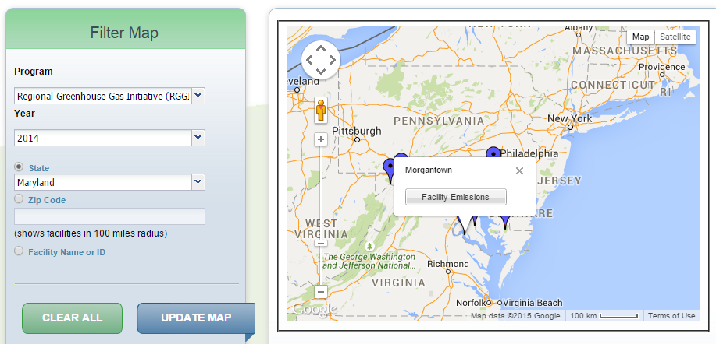
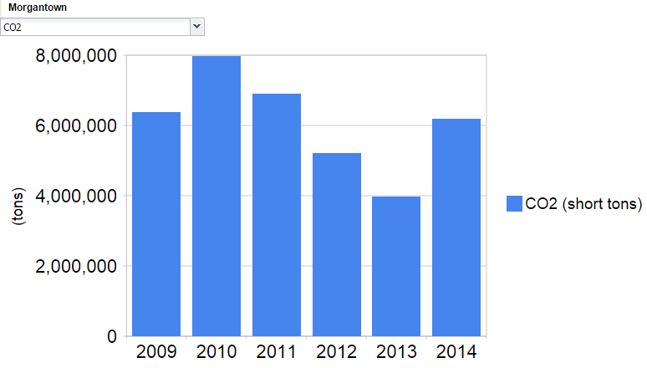
Gathering the data: EPA website

Slide 3
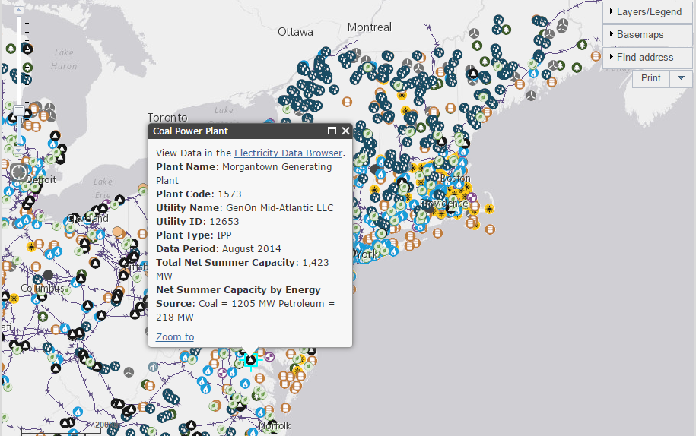
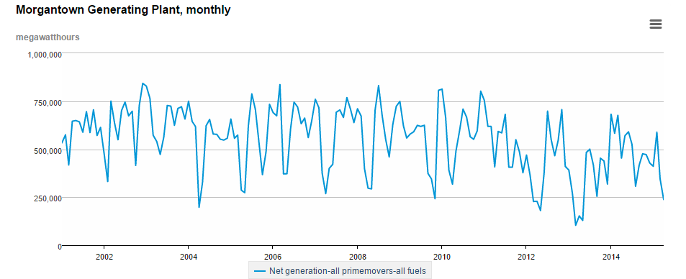
Gathering the data: EIA website

Slide 4
Gathering the data:
EPA: 1 spreadsheet
13k lines
EIA: 7 spreadsheets
6k plants
per Year 2009 to 2015
Data Frame 75k x 20
DPLYR and RESHAPE2 ARE MY NEW FRIENDS!

Slide 5
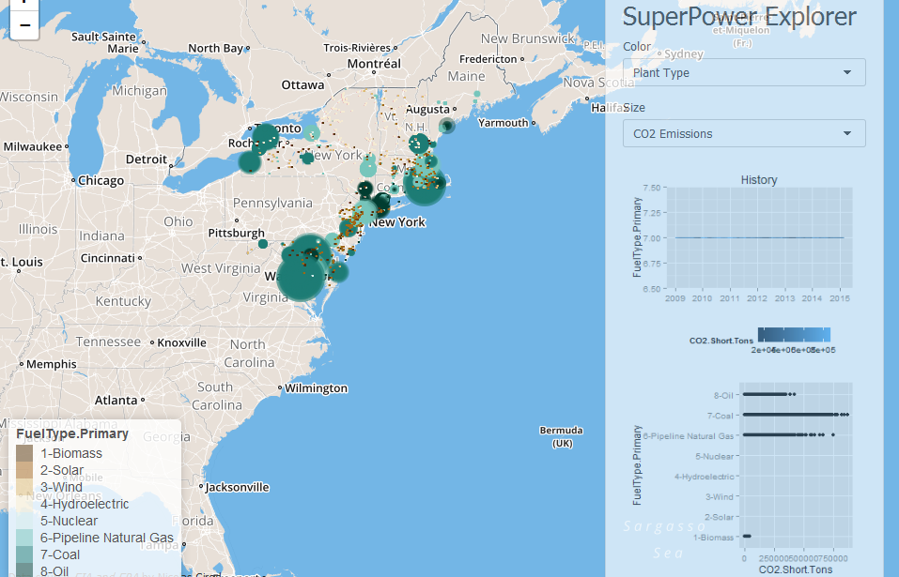
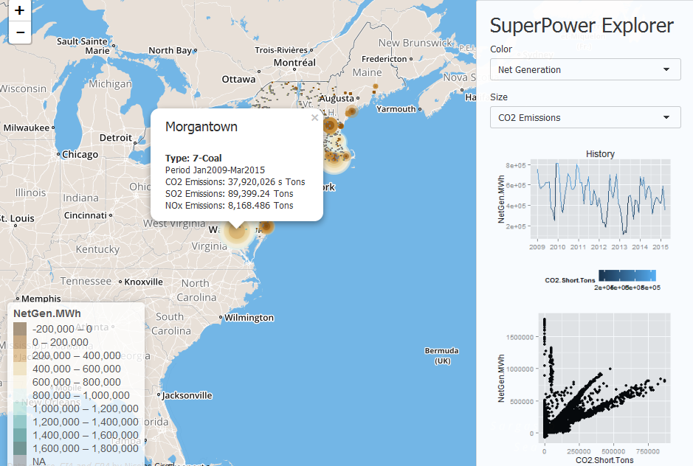
Shiny:

Slide 6
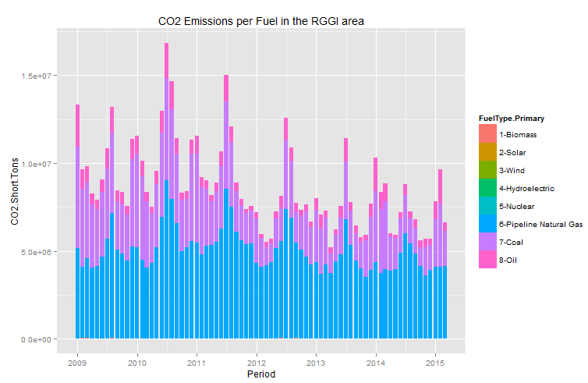
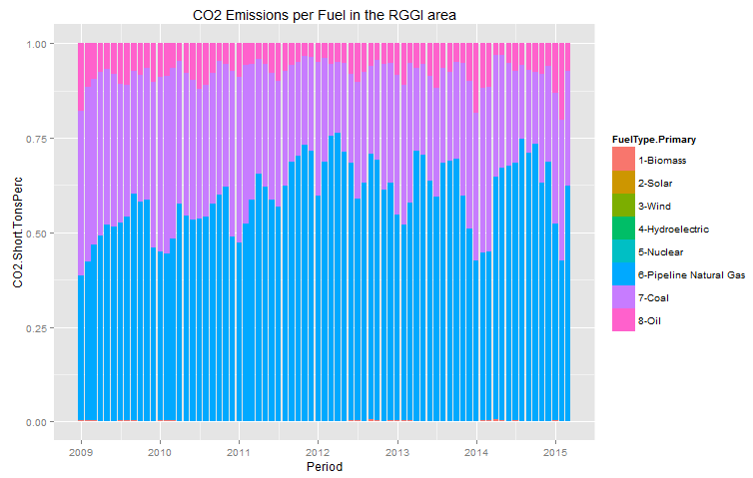
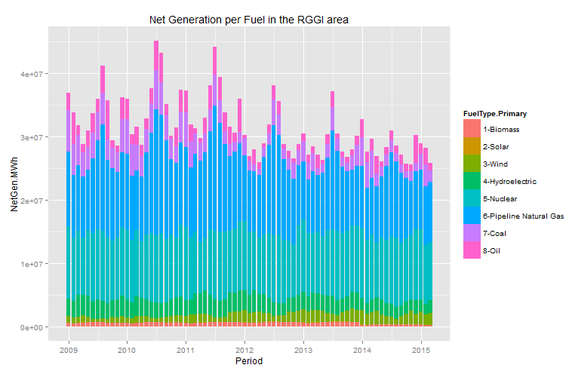
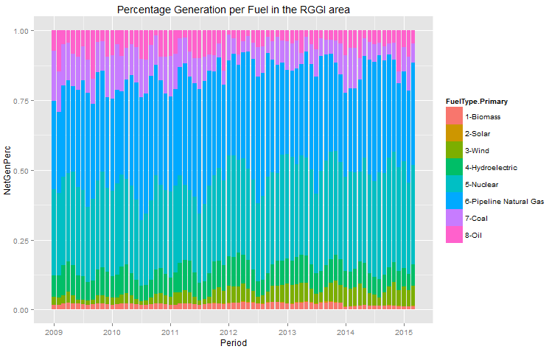
Did the RGGI Market deliver?

Slide 7
Did the RGGI Market deliver?
YES!
Power demand reduced (Thanks to auction proceeds - 60% of $1.4B)
Gas displaced Coal in the Power stack (Also due to lower Gas prices vs. Coal)
Next step: Increase incentives and subsidies for Greener production (Wind and Solar currently only 7% of auction proceeds).

